Slide 1
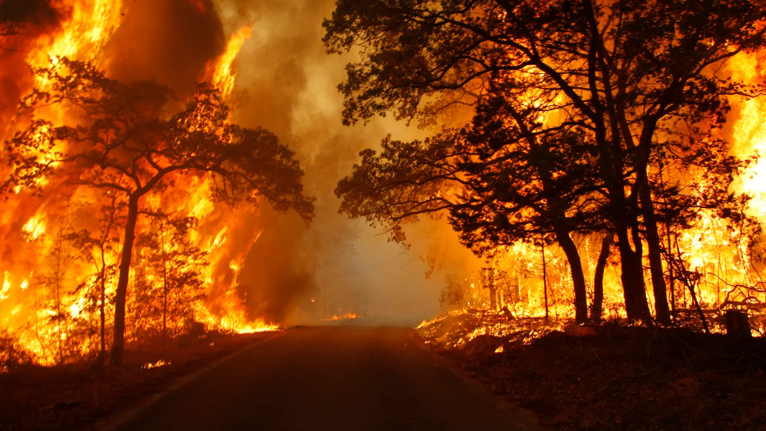
Alerting Model for Natural Disasters

Slide 2
Literature Review
literatures of existing disaster recognizing tools and systems.
Current Technologies used
Use case analysis and Gap analysis
Challenges
Notes:
Literature Reviews
https://www.geeksforgeeks.org/computer-networks/wireless-sensor-network-wsn/
Can we detect trends in natural disaster management with artificial intelligence? A review of modeling practices | Natural Hazards
AI-SocialDisaster: An AI-based software for identifying and analyzing natural disasters from social media – ScienceDirect
Enhancing-Disaster-Response-Systems-Predicting-and-Mitigating-the-Impact-of-Natural-Disasters-Using-AI.pdf
Applications of artificial intelligence for disaster management | Natural Hazards
AI for Natural Disaster Prediction and Management | SpringerLink
Applications of Artificial Intelligence in Disaster Management | Proceedings of the 2024 10th International Conference on Computing and Artificial Intelligence

Slide 3
Design parameters
Data collection
Data collection Tools
Notes:
https://www.kaggle.com/
https://ccl.northwestern.edu/netlogo/6.4.0/

Slide 4
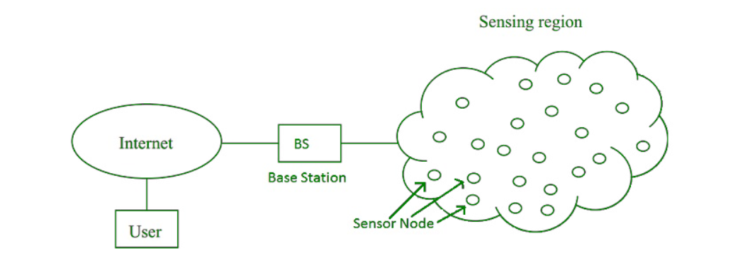
Notes:
Reference - https://www.geeksforgeeks.org/computer-networks/wireless-sensor-network-wsn/

Slide 5
Explanation & Demonstration
Use Open-Source Data and data from wireless sensor nodes to get the information.
Collect the data into a Central Location.
(HUB)
Data analyze with real Data
Analyzed data store in a Database
Finally, we develop a web page and alerting tool when triggers such a notification.
Start Analyzing

Slide 6
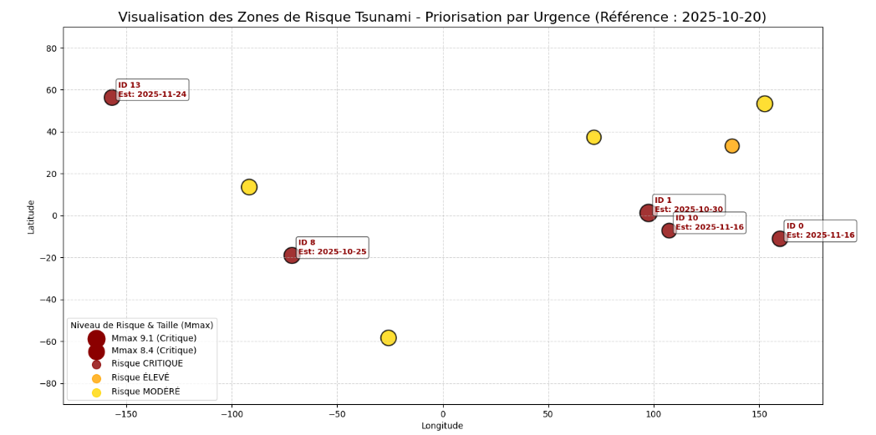
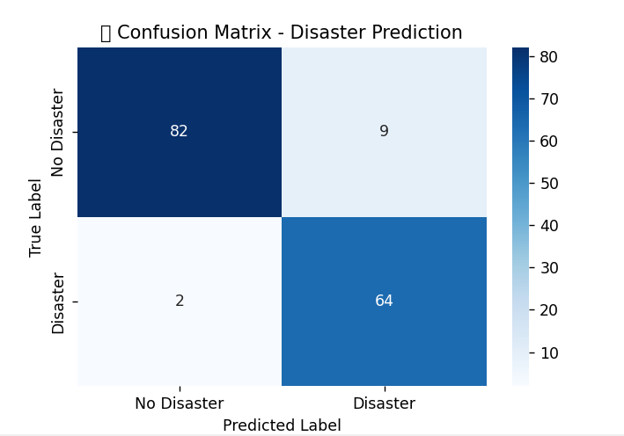
Demonstration

Slide 7
Evaluation
After analyzing, we evaluate either any disaster going to take place or not
For instance, we have trained model for evaluating Natural Disaster
We need to provide this data to our trained model and check its triggering an alert or not in next few hours (next 10 hours maybe).

Slide 8
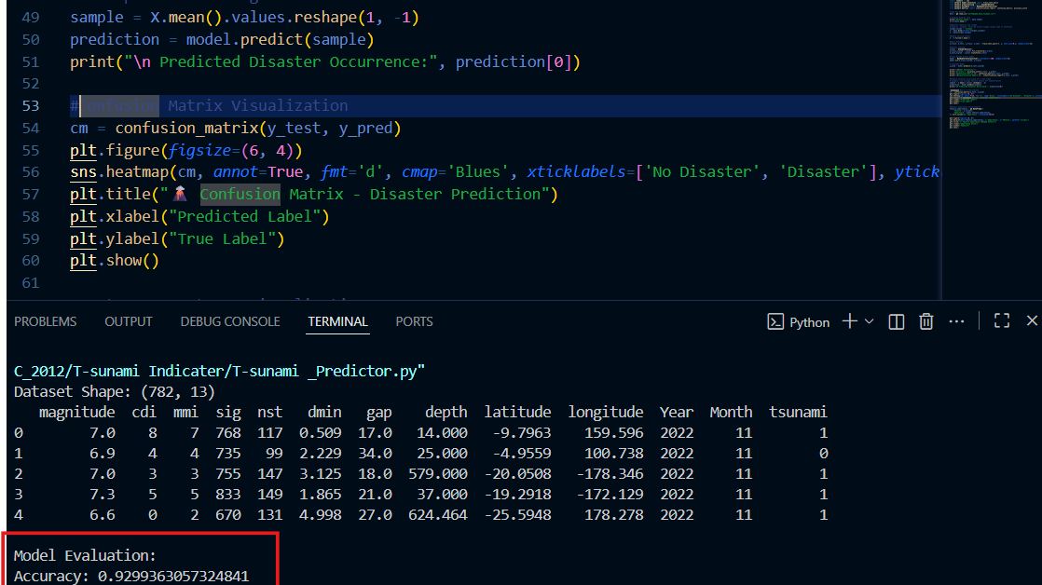

Slide 9
Communication
Release the article in the university of Vaasa publications.
Publish in other platforms as an example, Research Gate etc.

Slide 10
Q&A

